Slide 1

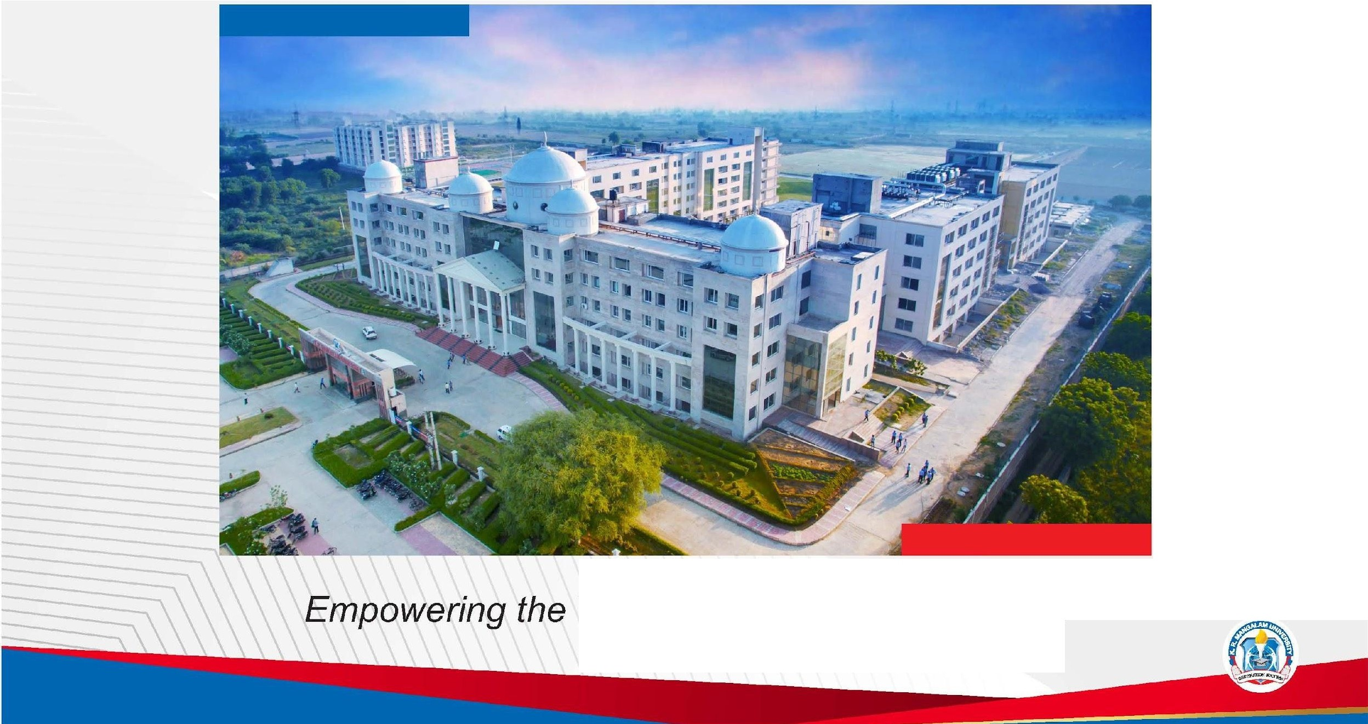
K.R. MANGALAM
'
UNIVERSITY
THE COMPLETE WORLD OF EDUCATION
Recognised under the section 2 (f) of the UGC Act 1956
Youth; Empowering the Nation

Slide 2


Design and Implementation of a Mini Relational Database Engine
2nd Year Project Synopsis
Submitted by
ROLL | NAME
2401730183 | Chirag Sharma
2401730170 | Vikram
2401730213 | Saurav Kumar
2401730196 | Ansh Jangid
2401730076 | Utkarsh
Faculty Mentor:
Mr. Vishwanil Suman

Slide 3

Project Overview
Databases are an essential part of modern software systems.
Most users interact with databases only through SQL commands.
Internal processes like query parsing, indexing, and execution remain hidden.
This project develops a simpliﬁed relational database engine.
Emphasis is on learning internal mechanisms rather than performance.

Slide 4
Specific Objectives
Understand internal working of database systems
Implement SQL parser, query planner, and execution engine
Learn ﬁle-based storage and indexing concepts
Gain hands-on experience with system-level programming

Slide 5
Key Features
Supports basic SQL commands: CREATE, INSERT, SELECT.
File-based data storage for persistence. Indexing support using B+ Tree.
Modular and extensible system architecture. Simple command-line interface for interaction.

Slide 6
Project Usecases & Scope
Use Cases:
Academic learning tool for DBMS concepts.
Understanding query execution ﬂow.
Demonstration of indexing and storage techniques.
Scope:
Single-user system.
Supports limited SQL syntax.
No transaction or concurrency support.
Designed for educational purposes only.

Slide 7

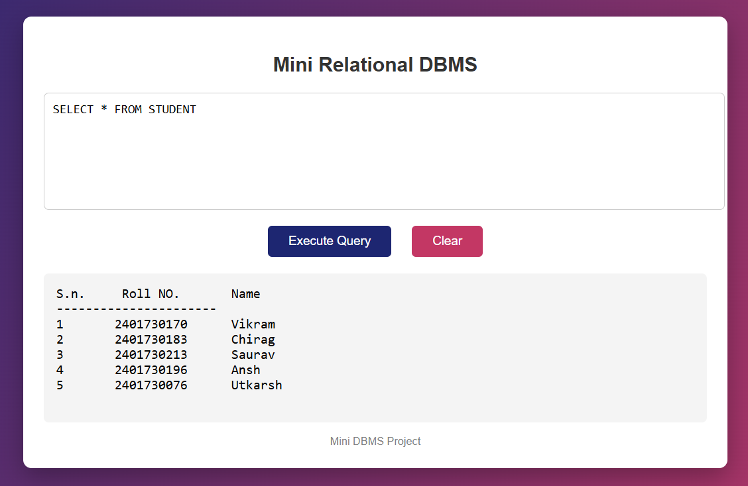
Prototype

Slide 8
Data & Resources
Data stored in binary ﬁles on disk.
Tables stored as structured records.
Index ﬁles maintained separately.
No external database dependency.
Uses local ﬁle system for storage.

Slide 9

Methodology
Requirement analysis of DBMS components.
Design of modular architecture.
Implementation of individual modules.
Unit testing of each component.
Integration and system testing.

Slide 10
Expected Results & Impact
Functional mini relational database engine.
Correct execution of basic SQL queries. Clear understanding of DBMS internals. Improved system-level programming skills.
Strong foundation for advanced database studies.

Slide 11
Project Timeline
Completed Phases
Week 1 - Requirement Analysis & Problem Understanding
Week 2 - System Architecture & Module Design
Week 3–4 - SQL Parser Implementation & Storage Design & Execution Engine
Upcoming Phases
Query Planner
Indexing using B+ Tree
Testing & Validation
Documentation & Deployment

Slide 12

THANK YOU

